Slide 1
Telecom churn prediction

Slide 2
INTRODUCTION
Churn prediction is a widely used application of Big Data in business, aiming to identify customers who are at risk of discontinuing their service subscriptions.
This issue is particularly significant for telecom companies, as retaining existing customers is generally more cost-effective than acquiring new ones.

Slide 3
Project Objective
To predict Customer Churn.
Identify the primary variables and factors contributing to customer churn.
Utilize various machine learning algorithms to develop predictive models.
Assess the accuracy and performance of these models.
Determine the most effective model for our business needs and provide an executive summary of our findings.

Slide 4
Churn prediction model
Training data
(5)Update
(1)Build
Model
Real
independent
(4)Predict
(2)Test
Testing data
(3)Test=Ok

Slide 5
Exploratory Data Analysis
Data visualisation using seaborn and matplotlib
Exploratory data analysis (EDA) is an approach to analyse data sets & to summarize their main characteristics, often with visual methods.
A Statistical model can be used or not, but primarily EDA is for seeing what the data can tell us beyond the formal modelling or hypothesis.

Slide 6
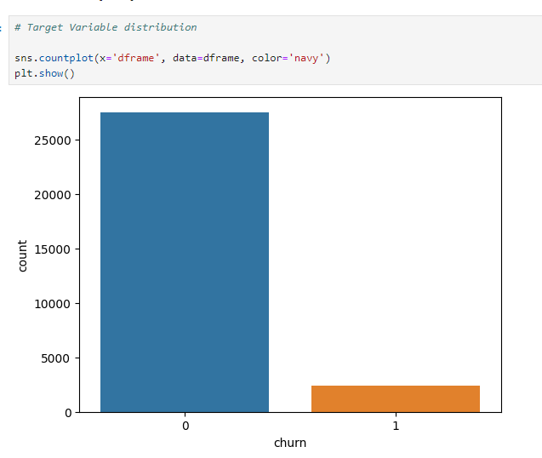
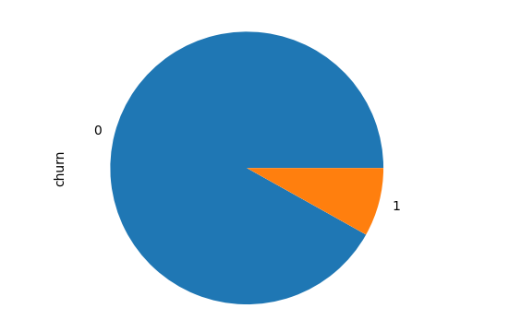
Bar Graph
Since 91.9% of the customers do not churn, this indicates possibility of class imbalance.

Slide 7
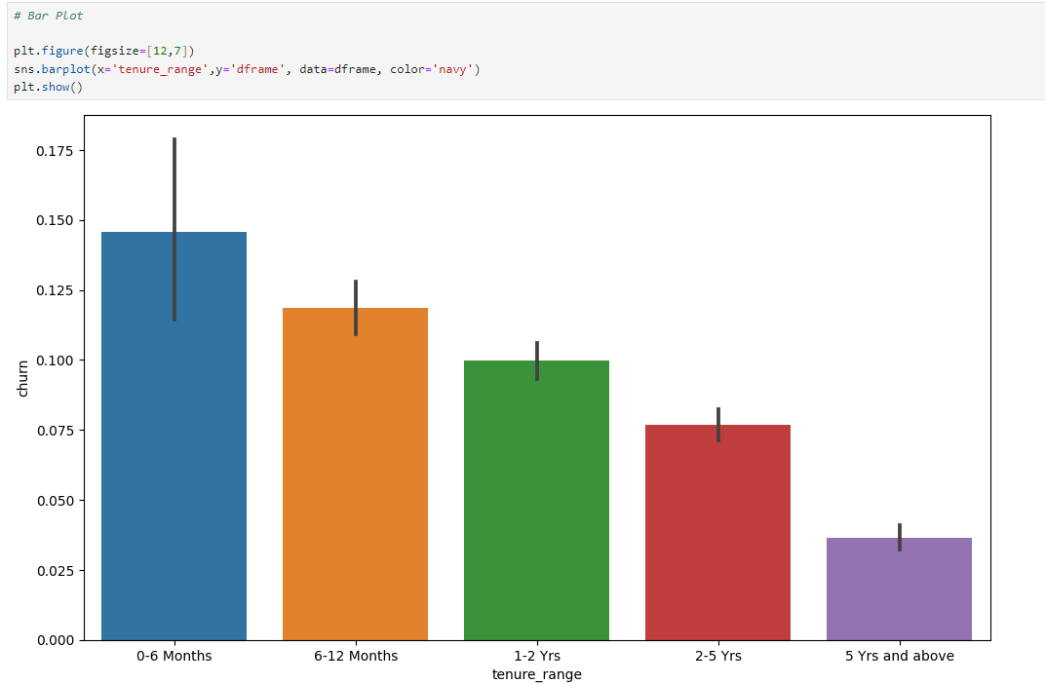
BAR Plot
As can be seen from the bar plot, churn decreases as the duration of services increases
Therefore the company should focus on offering better plans to shorter tenure subscribers.

Slide 8
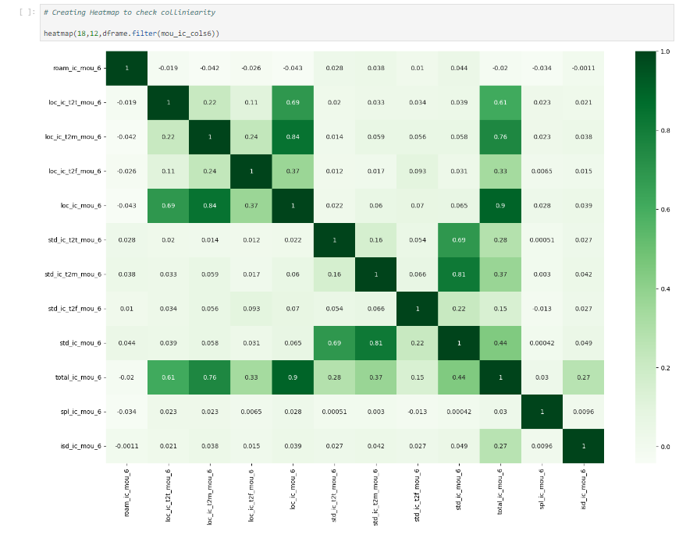
Heat map
Correlation: Dependence or association is any statistical relationship, whether causal or not, between two random variables or bivariate data. With the help of Correlation matrix, we can find interdependency between variables
As can be seen that total_ic_mou_6, std_ic_mou_6 and loc_ic_mou_6 have a strong correlation with other fields

Slide 9
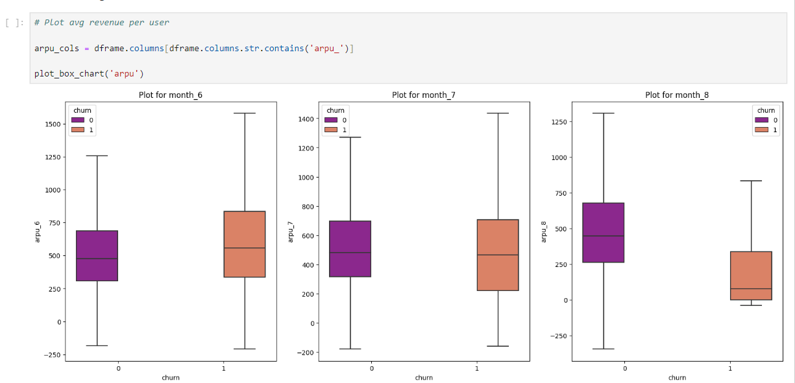
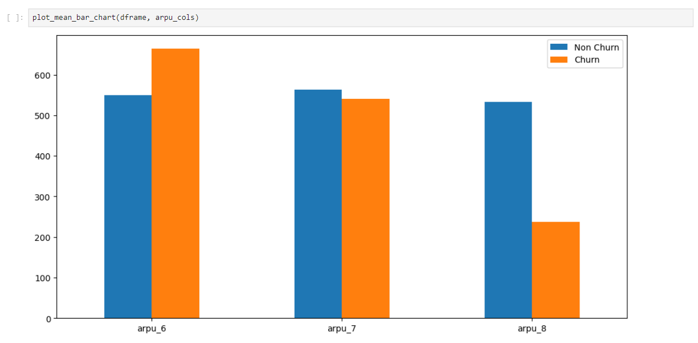
Average Revenue per user
There is a huge drop in Average revenue per user in the Action phase for churned customers

Slide 10
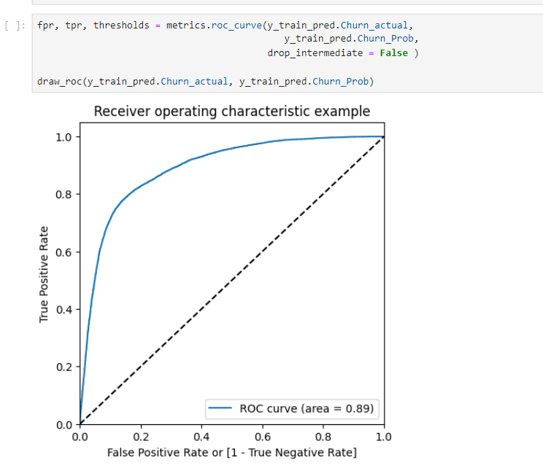
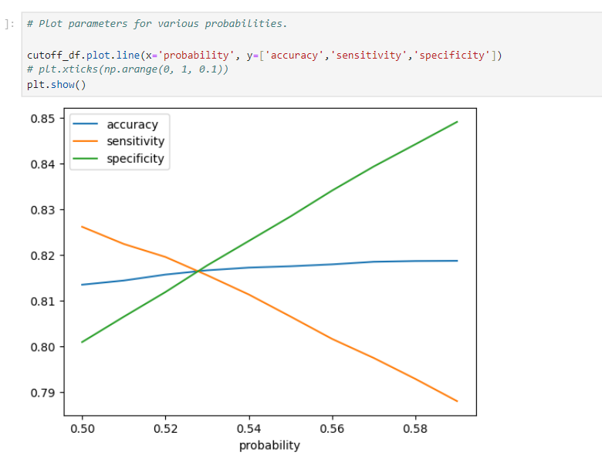
ROC Curve & Optimal Cutoff
Area under ROC curve is 0.89 and optimal cutoff point converges at 0.53

Slide 11
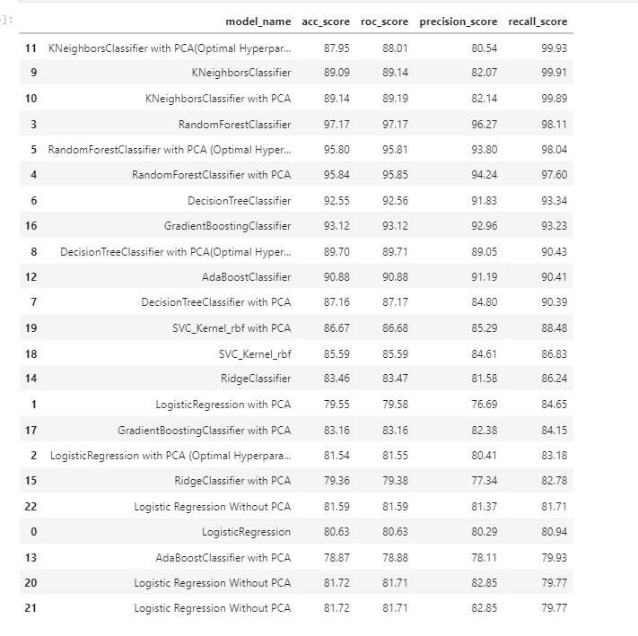
Scores OF VARIOUS MODELS

Slide 12
Most Important predictors
fb_user_8_1.0 : Service scheme to avail services of Facebook and similar social networking sites during the month of August.
sep_vbc_3g : Volume-based charges for 3G services in September. It indicates additional charges incurred by customers for exceeding data limits.
night_pck_user_6_0.0 : Prepaid night packs consumed during the month of June.
max_rech_data_6 : Maximum recharge amount by a user in June.
arpu_7 : Average revenue per user for the month of July

Slide 13
Recommendations
Target retention for customers with less than 4 years of service duration. Offer loyalty programs or incentives to increase engagement.
Improve ARPU: Look at high-ARPU customers who stay and try to their successful strategies for at-risk customers.
Incoming & outgoing roaming calls during Action phase are strong indicators of churn.
Revise Facebook user pack pricing if it contributes to churn, or offer more value-added services.
Engage customers with decreased incoming local and outgoing ISD call usage, especially in August, with personalized offers.
Monitor value-based cost increases during the action phase and offer targeted promotions, loyalty rewards etc.`

